Slide 1




SALES DATA ANALYTICS: EXTRACTING INSIGHTS FOR BUSINESS GROWTH
Project Overview: Comprehensive analysis of sales data to identify key patterns, classify customer segments, and extract actionable insights for sustainable business growth
Presented by: Abu Sofian
Date: 12 September 2025

Slide 2


Tool Used
Microsoft Excel | Canva | IBM Granite
Used for data cleaning, processing, and generating reports to identify key insights. | Used for creating professional visuals and presentation designs. | A large language model applied for natural language processing and generating analytical insights.
Google Colab | Replicate | LangChain
A cloud-based environment for writing and running Python code interactively, especially for data analysis. | A platform for running and deploying machine learning models via API. | A framework for building applications with large language models, enabling chaining of prompts, integration with external tools, and workflow automation.

Slide 3
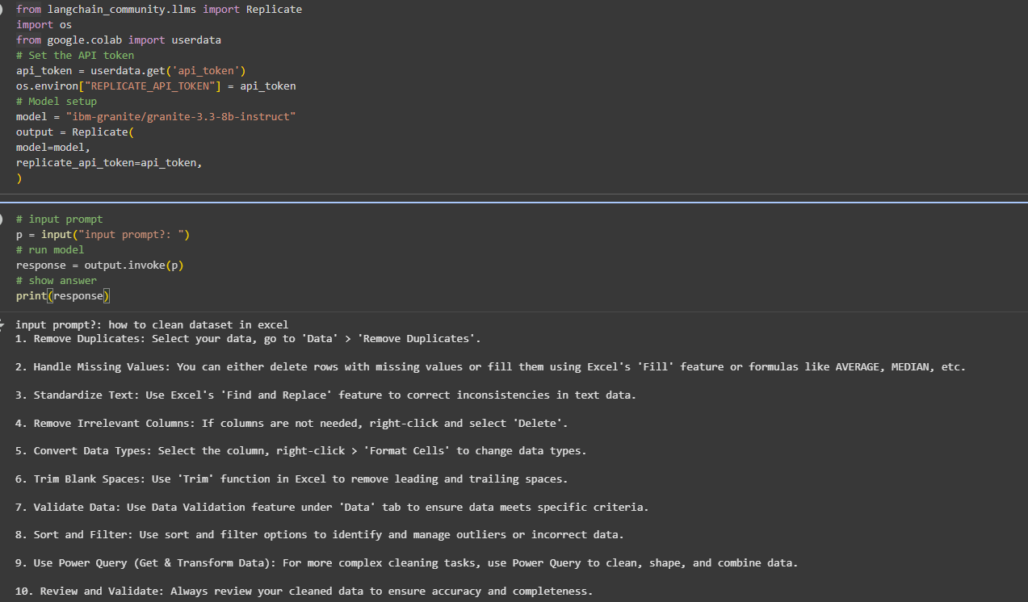
Tool in Action
IBM Granite

Slide 4
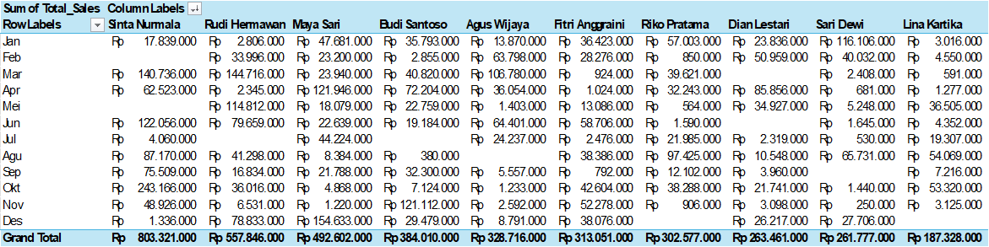
Tool in Action
Microsoft Excel - Pivot Table

Slide 5



Data Overview & Methodology
DATA OVERVIEW
01
Dataset: 2023 Sales Records (300+ transactions)
02
Revenue: Rp 4.04 billion
03
Categories: Electronics & Fashion
04
Period: 12-month analysis
METHODOLOGY
01
Data preprocessing & classification
02
Performance analysis & trend identification
03
Strategic insight extraction & recommendations

Slide 6


Executive Summary
This comprehensive sales data analytics project examines our 2023 business performance to unlock growth opportunities and optimize revenue strategies.
Key Focus Our 12-month analysis covers multi-city customer behavior, seasonal patterns, and product performance to identify growth opportunities and optimize business strategies.
Expected Impact Data-driven insights will enable customer segmentation optimization, product portfolio enhancement, and targeted revenue acceleration strategies.

Slide 7
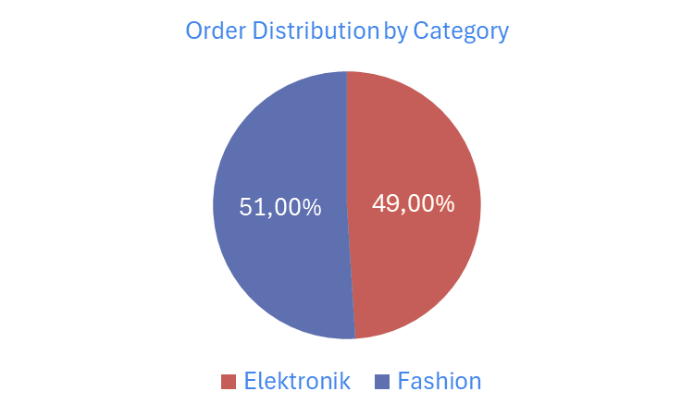

Data Classification Results
The analysis reveals a well-balanced product portfolio with Electronics contributing 49% (147 orders) and Fashion 51% (153 orders) of total transactions. Our customer base spans multiple Indonesian cities including Jakarta, Bandung, Surabaya, and Medan, demonstrating strong geographic diversification. Temporal analysis shows consistent year-round performance with notable peaks in October (34 orders) and strong performance in August and September (27 orders each), indicating clear seasonal opportunities.

Slide 8

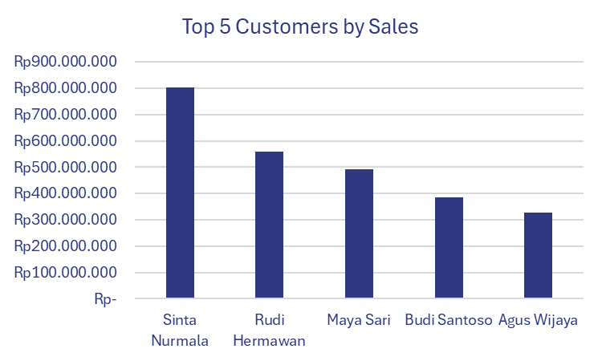
Customer Behavior Analysis
Customer performance analysis identifies significant revenue concentration among top performers, with Sinta Nurmala leading at Rp 803 million, followed by Rudi Hermawan (Rp 558M) and Maya Sari (Rp 493M). This concentration pattern reveals the critical importance of key account management and customer retention strategies. Payment method preferences show healthy diversification across Credit Card, Bank Transfer, PayLater, QRIS, and Cash on Delivery options, indicating flexible customer payment behaviors across different segments and geographic locations.

Slide 9

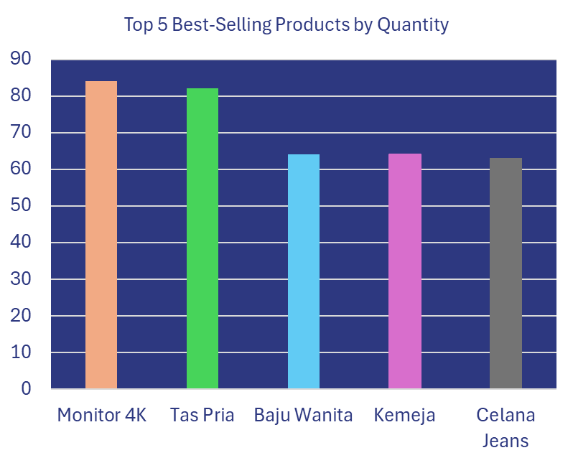
Product Performance Insights
Product quantity analysis reveals Tas Pria as the highest-volume seller with 83 units, closely followed by Monitor 4K (84 units) and Baju Wanita (64 units), demonstrating strong cross-category performance. Brand analysis shows XIAOMI, ASUS, LG, and SONY leading in Electronics, while NIKE, ADIDAS, ZARA, and H&M dominate Fashion categories. The data indicates consistent demand patterns throughout the year with Electronics showing seasonal peaks and Fashion maintaining steady performance, creating inventory optimization opportunities.

Slide 10
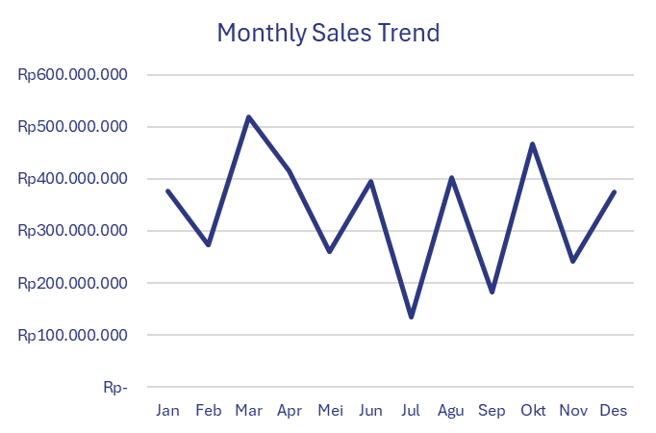

Sales Performance Trends
Monthly revenue analysis demonstrates clear seasonal patterns with identifiable peak performance periods that correlate strongly with order volume fluctuations. The revenue trajectory shows consistent performance throughout 2023 with notable seasonal variations that provide forecasting opportunities. Category comparison reveals balanced contribution from both Electronics and Fashion segments, with each showing distinct seasonal characteristics that can inform targeted marketing and inventory strategies.

Slide 11

Key Business Insights
Critical analysis reveals that customer concentration among top performers creates both opportunity and risk, requiring strategic customer relationship management. The near-equal split between Electronics and Fashion categories provides portfolio stability and reduces market dependency risks. Geographic diversity across multiple Indonesian cities demonstrates strong market penetration while revealing expansion opportunities in existing and new markets. Strong customer loyalty evidenced by repeat purchases indicates effective customer satisfaction and retention potential.

Slide 12


Strategic Recommendations
Customer strategy should prioritize developing VIP programs for top revenue contributors while implementing retention strategies for mid-tier segments and pursuing geographic expansion in high-performing cities. Product optimization requires increased inventory allocation for best-selling items like Tas Pria and Monitor 4K, seasonal planning based on monthly performance trends, and cross-category bundling initiatives. Revenue acceleration opportunities include focused marketing during peak months, payment method optimization for enhanced customer convenience, and targeted acquisition campaigns for underperforming segments.

Slide 13


Implementation Roadmap
Immediate actions for the next 1-3 months include launching a comprehensive top customer loyalty program, optimizing inventory levels for best-performing products, and implementing targeted seasonal marketing campaigns. Short-term goals spanning 3-6 months focus on geographic market expansion planning, developing cross-category product bundling initiatives, and refining customer segmentation strategies. Long-term strategy over 6-12 months involves implementing advanced analytics capabilities, developing predictive modeling for demand forecasting, and comprehensive market expansion initiatives.

Slide 14


Conclusion & Next Steps
This comprehensive sales data analytics project successfully transforms raw transaction data into strategic business intelligence, revealing critical insights about customer behavior, product performance, and market opportunities. The balanced portfolio between Electronics and Fashion, strong customer loyalty indicators, and clear seasonal patterns provide solid foundation for growth. Next steps include immediate implementation of recommended strategies, establishing performance monitoring systems, and developing advanced analytics capabilities for continuous business optimization and sustainable growth acceleration.

Slide 15

Thank You
Contact Information:
📧 Email: abusofian.id@gmail.com
💼 LinkedIn: https://www.linkedin.com/in/abusofianid
🔗 Project Repository: https://github.com/abusofianid

